Slide 1
Ruby sudoku master
By Jack Toke

Slide 2
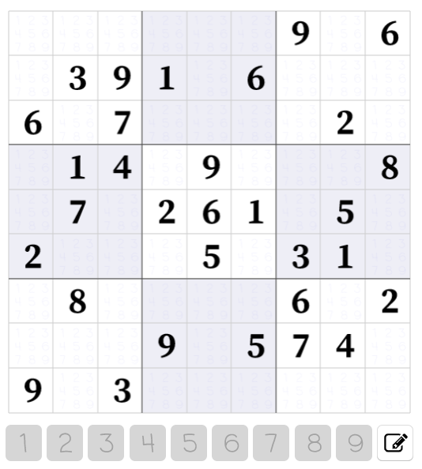

Slide 3
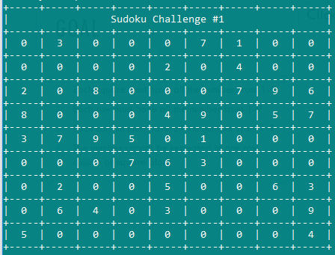
Goal
Each square must have all the number from 1-9
Each row must have all the number from 1-9
Each column must have all the number from 1-9
The number cannot be repeated in any row, column or square block

Slide 4
Strategy
1. Build a list of all potential values for each cell and then shed the lists until there is only one possible value

Slide 5
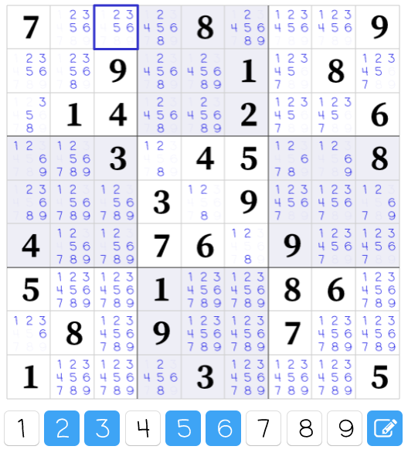
Strategy 1
Build a list of all potential values for each cell
shed the lists until there is only one possible value

Slide 6
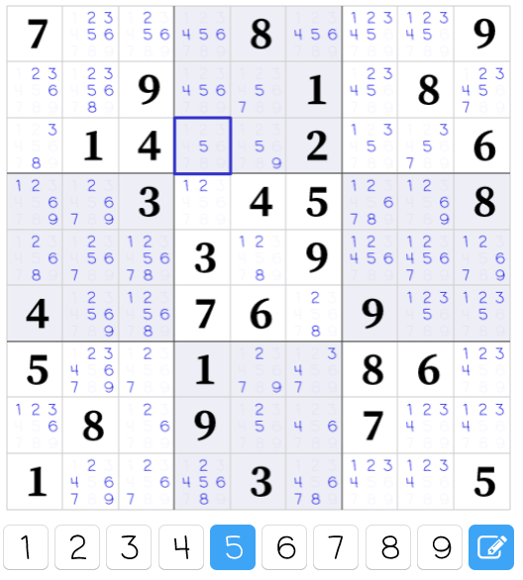
Strategy 1
Build a list of all potential values for each cell
shed the lists until there is only one possible value

Slide 7
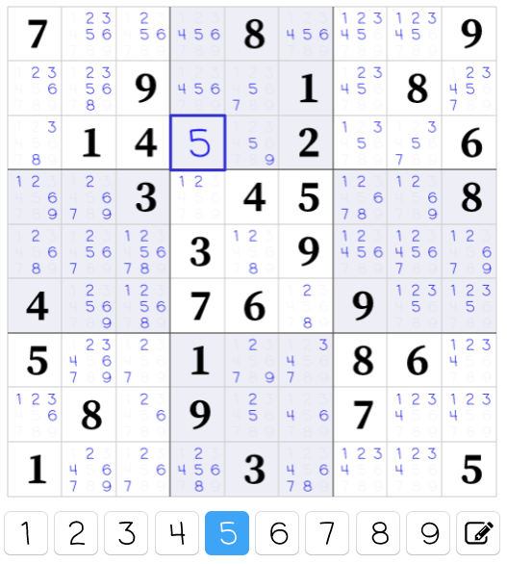
Strategy 1
Build a list of all potential values for each cell
shed the lists until there is only one possible value

Slide 8
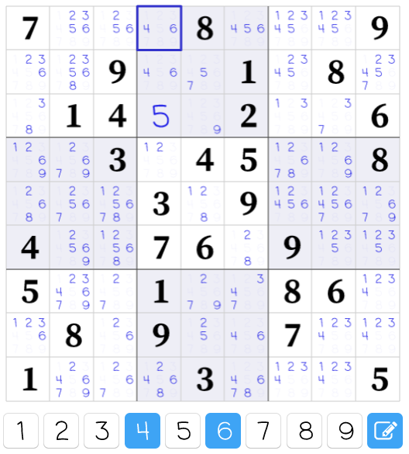
Strategy 1
Build a list of all potential values for each cell
shed the lists until there is only one possible value

Slide 9
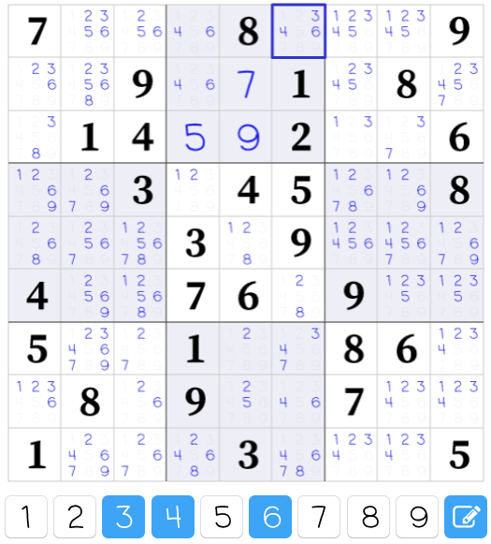
Strategy 2
If two cells in the same row, column or square block have the same potential values, then no other cells in the same row, column or square block can have those values.
Remove those values from all other cells in the same row, column or square block where the

Slide 10
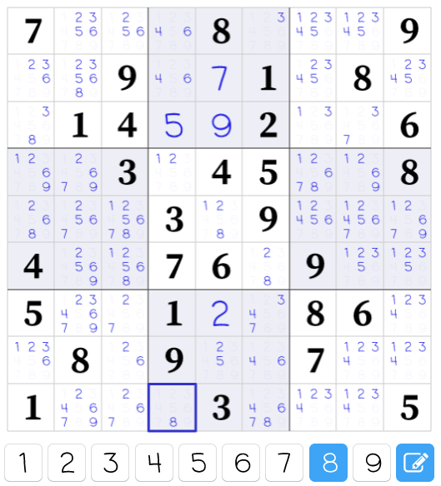
Strategy 2
If two cells in the same row, column or square block have the same potential values, then no other cells in the same row, column or square block can have those values.
Remove those values from all other cells in the same row, column or square block where the

Slide 11
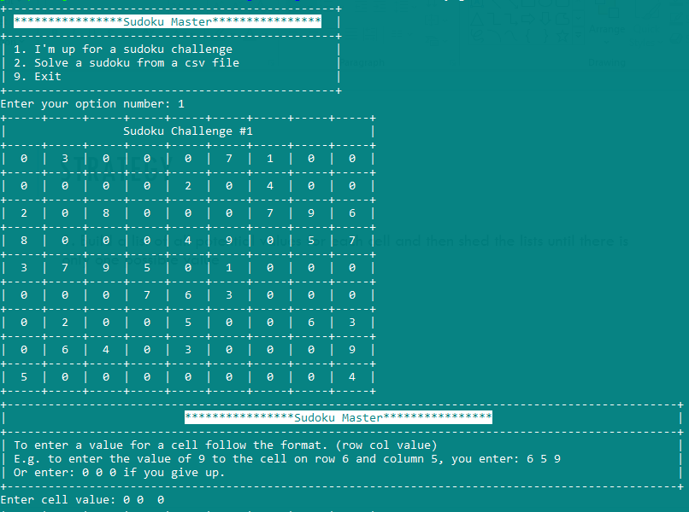

Slide 12
Strategy
1. Build a list of all potential values for each cell and then shed the lists until there is only one possible value

